Slide 1
Introduction to
Illumina sequencing and mNGS data analysis
Rapid Response – Updated January 2026

Slide 2







mNGS pipeline
Study design
xNA extraction
Library prep
Sequencing
Data analysis
Pathogen ID
Type(s)
Controls
Storage
Lab setup
Type(s)
Controls
QC
Host removal
Fragmentation
dsDNA generation
End-repair
Adapter ligation
Barcoding & PCR
Clean-up
Pooling
QC
Machine
Read length
Loading conc.
QC data
Host removal
Alignment
Blast
Ranking of hits
INTRODUCTION

Slide 3
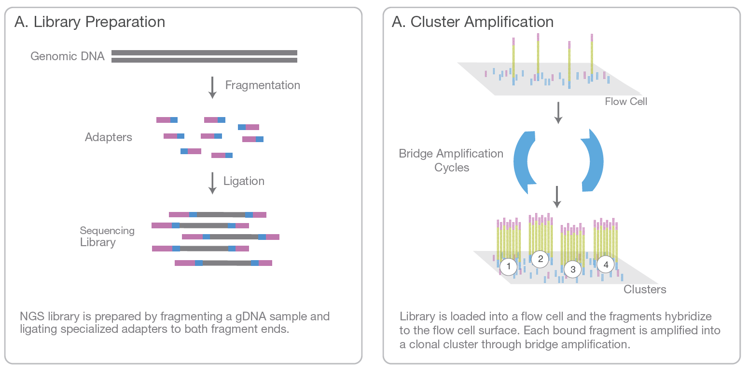

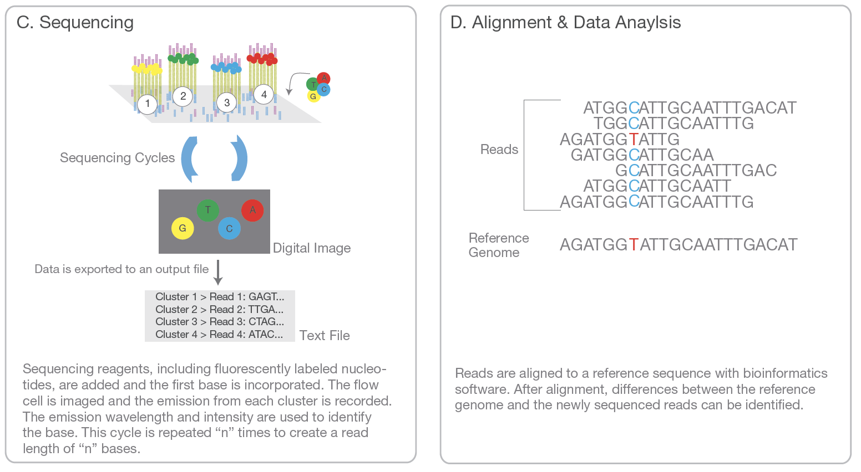
B. Cluster Amplification
Introduction to illumina Next-Generation sequencing (NGS)
Notes:
From: Illumina_sequencing_introduction.pdf

Slide 4
Next-generation sequencing (NGS)
What is a library?
What is a read?
What is paired-end sequencing?
What is a cluster?
What is (de-)multiplexing?
What is a fastq file?
What is coverage?

Slide 5
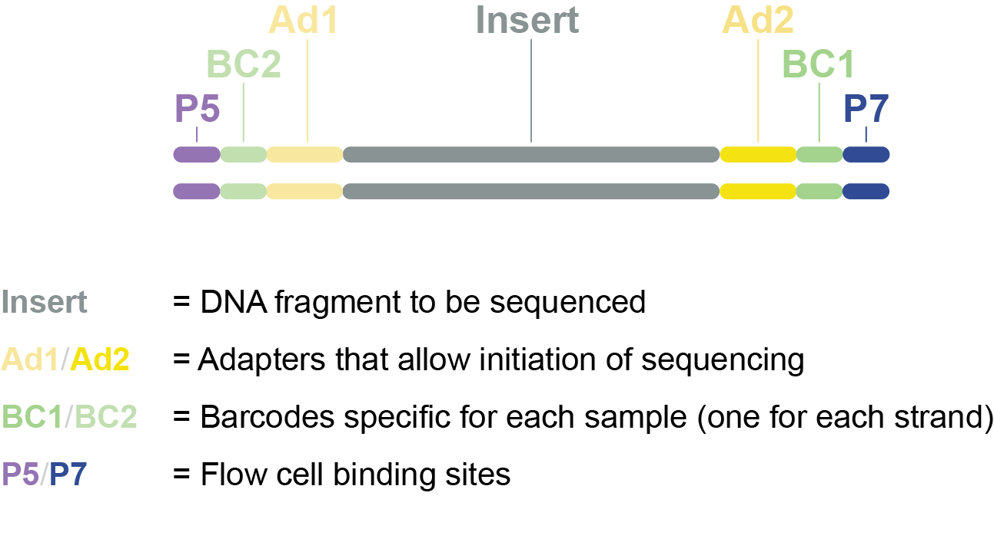
Sequencing library = collection of fragments ready for sequencing
DNA is fragmented into smaller pieces, optimal for sequencing
Adapter sequences, barcode sequences and flow cell binding sites are added to allow the sequencing process to occur
Sample library

Slide 6
Next-generation sequencing (NGS)
B. Cluster Amplification
Notes:
From: Illumina_sequencing_introduction.pdf

Slide 7
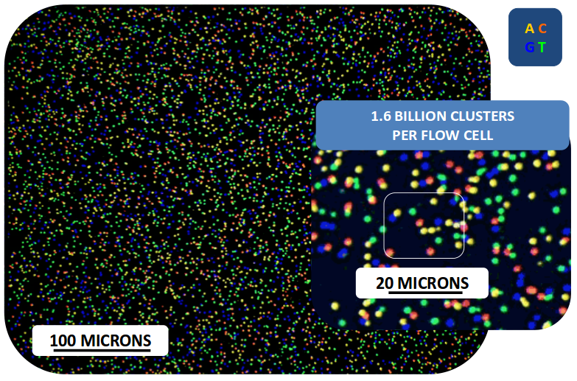
Next-generation sequencing (NGS)
Notes:
From: Illumina_sequencing_introduction.pdf

Slide 8
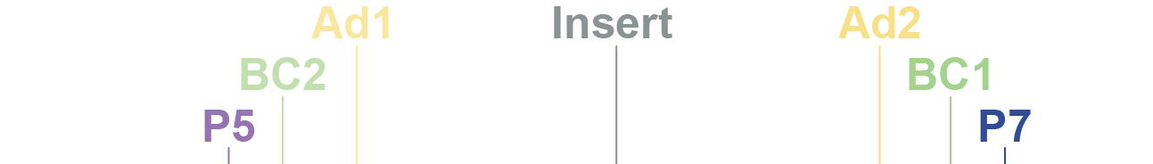
Sequencing process
F
L
O
W
C
E
L
L
F
L
O
W
C
E
L
L
Read 1
Read 2

Slide 9
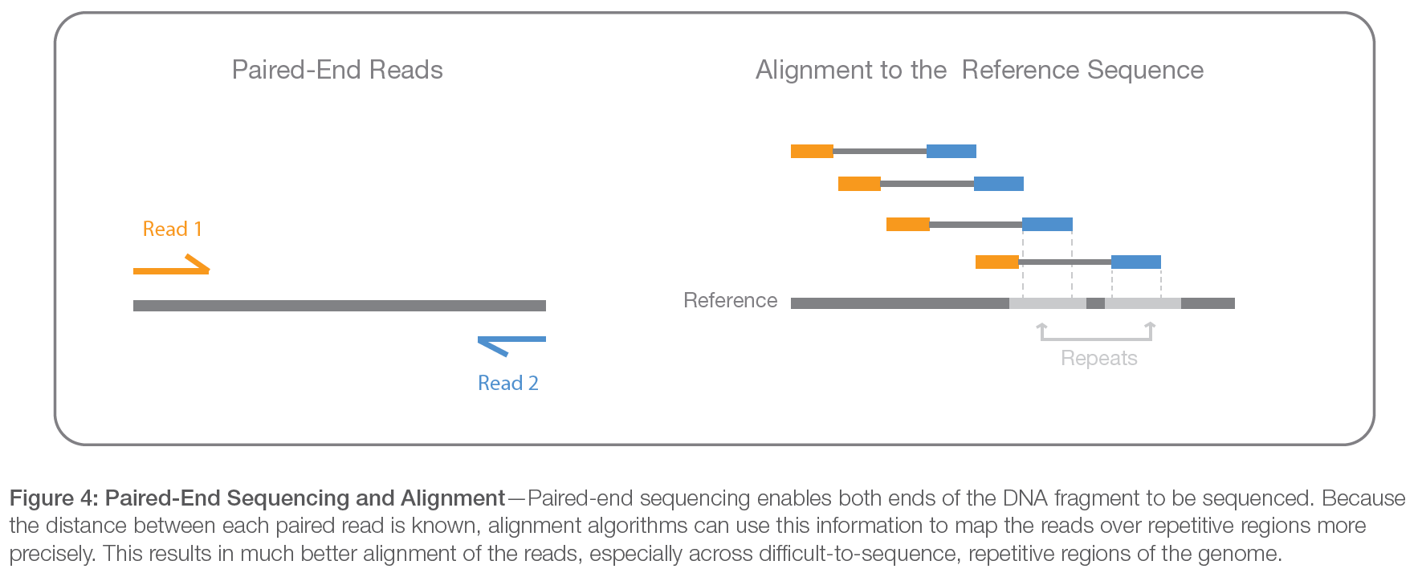
Next-generation sequencing (NGS)
Paired-end sequencing
Notes:
From: Illumina_sequencing_introduction.pdf

Slide 10
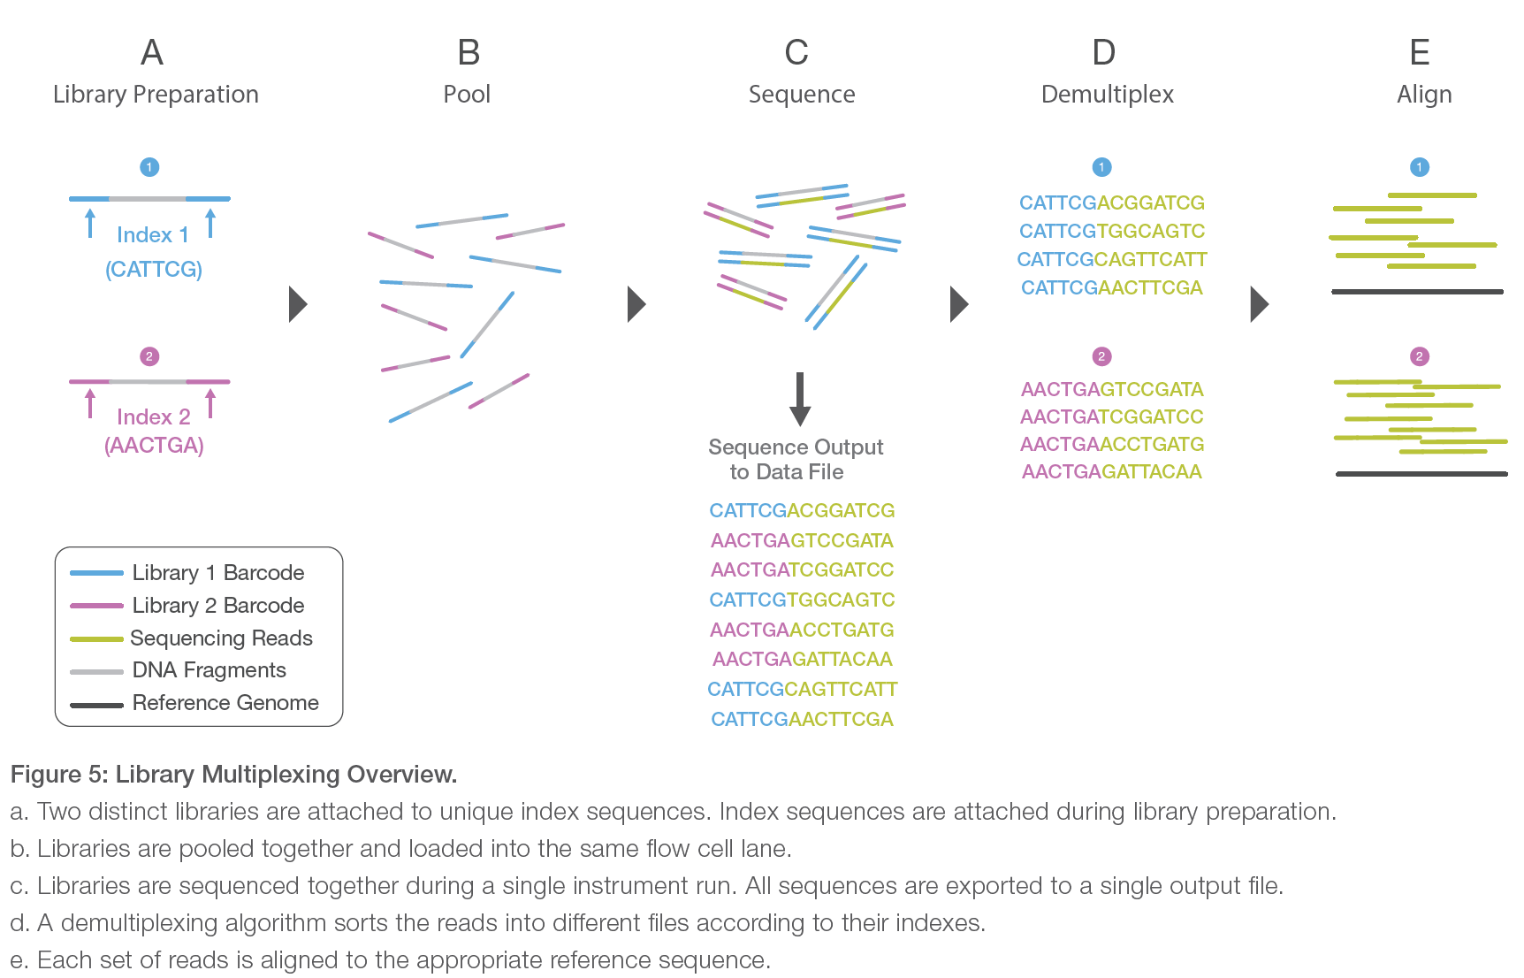
Next-generation sequencing (NGS)
Multiplexing or Pooling = Sequencing multiple samples together in one reaction
Notes:
From: Illumina_sequencing_introduction.pdf

Slide 11
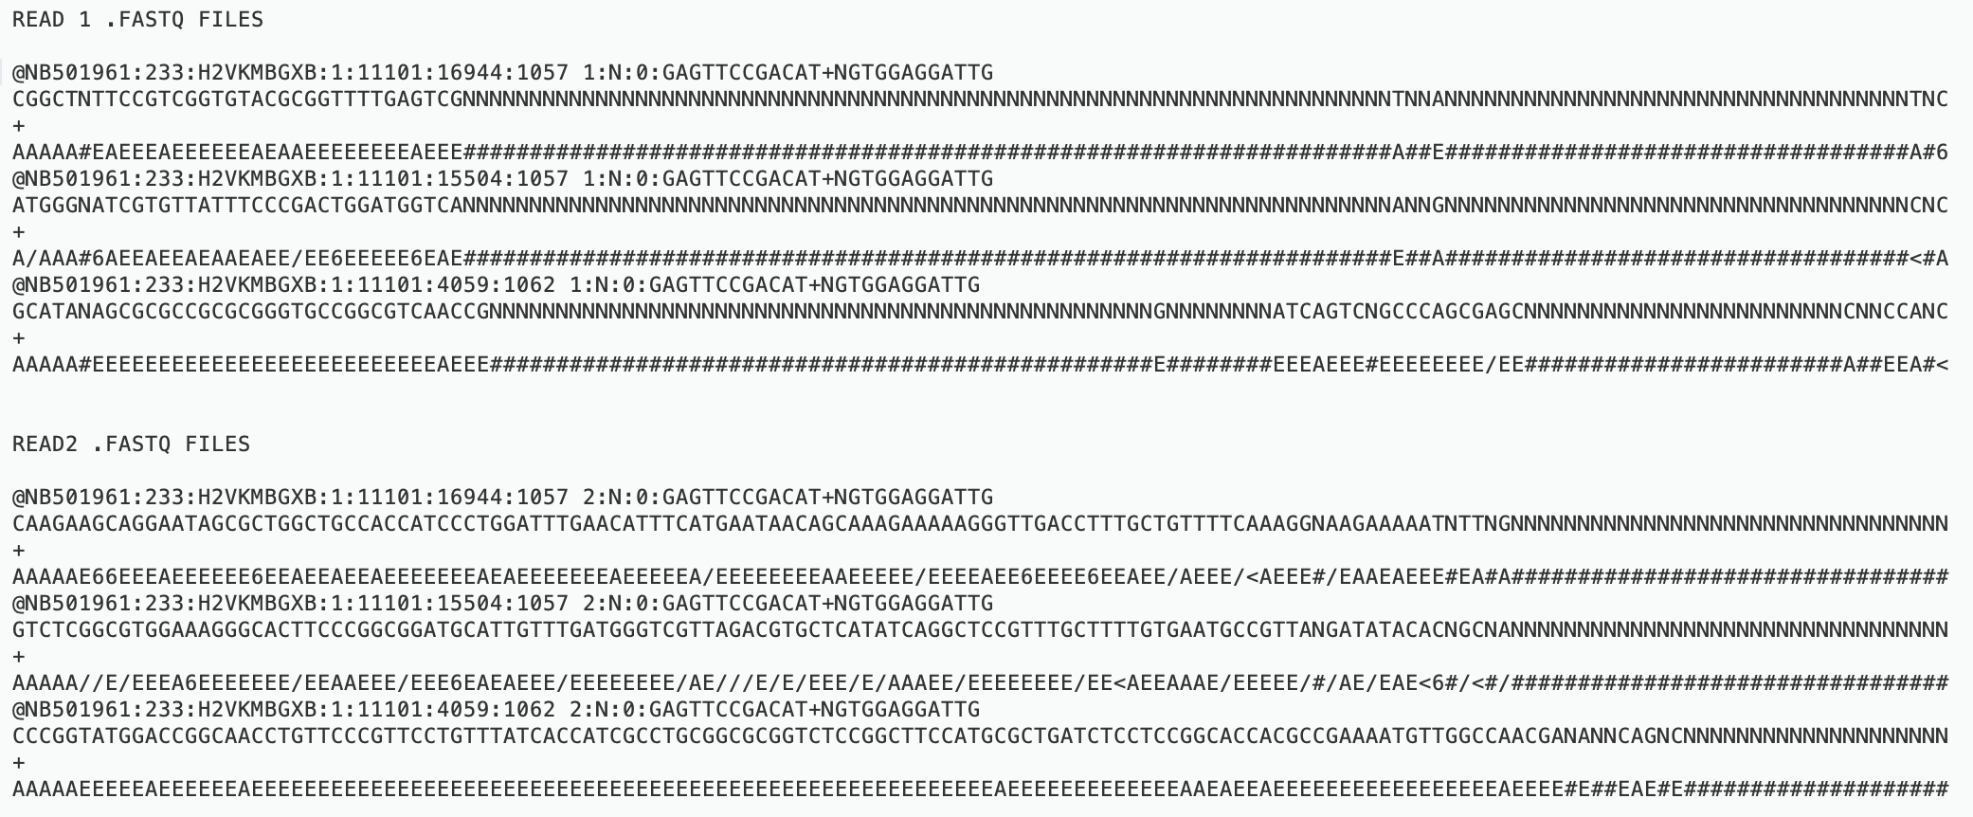
fastq file = raw data file containing sequencing data, generated by sequencer
Sequencer will demultiplex sequencing data, resulting in a two fastq files per sample (read 1 and read 2)

Slide 12
fastq file = raw data file containing sequencing data, generated by sequencer
Example Read1.fastq
@NB501961:14:HM7TLBGX2:1:11102:3233:17234 1:N:0:GATCACCA+GATCACCA
CATTCGGCTGGGTTTCGTCACCCTGCGGGAAGATGCGGGTCCAGGCGATAGAGGTGCGGAAGCATTTGAAGCCCA
+
AAAAAEEEEEEEEEE/EEEEEEEEEEEEEEEEEEEEEE<EEEEEEEEE//EAEEEEEEAA/EEE/EEAAEEE<6/
Each read is described by 4 elements in 4 lines:
A sequence identifier with information about the run (always starts with ‘@’)
The base calls: A, C, T, G and N
A separator, which is simply a plus (+) sign
The base call quality scores (coded in ascii format)
Quality Score | Probability of Incorrect Base Call | Inferred Base Call Accuracy
10 (Q10) | 1 in 10 | 90%
20 (Q20) | 1 in 100 | 99%
30 (Q30) | 1 in 1000 | 99.90%
@<instrument>:<run number>:<flowcell ID>: <lane>:<tile>:<x-pos>:<y-pos> <read>:<is filtered>:<control number>:<sample number>
Q = -10log₁₀(e)
Notes:
@<instrument>:<run number>:<flowcell ID>:<lane>:<tile>:<x-pos>:<y-pos> <read>:<is filtered>:<control number>:<sample number>

Slide 13
Coverage = How many times a base has been sequenced
Coverage = How many times each base has been sequenced on average throughout the genome
Coverage depth = 16
Coverage depth = 10
Reads aligned to reference genome
Coverage depth = 4
Reference genome
Notes:
A higher coverage results in a higher quality (fewer ‘false’ mutations).

Slide 14
Disclaimer
This training resource was developed to be used with the CZ ID platform
In October, 2026, stewardship of CZ ID transitioned to UCSF and the platform was renamed to SeqtoID
These training materials are not being actively maintained and may not reflect differences between CZ ID and SeqtoID, subsequent changes to the platform, or current methods and best practices in metagenomic sequencing and analysis

Slide 15


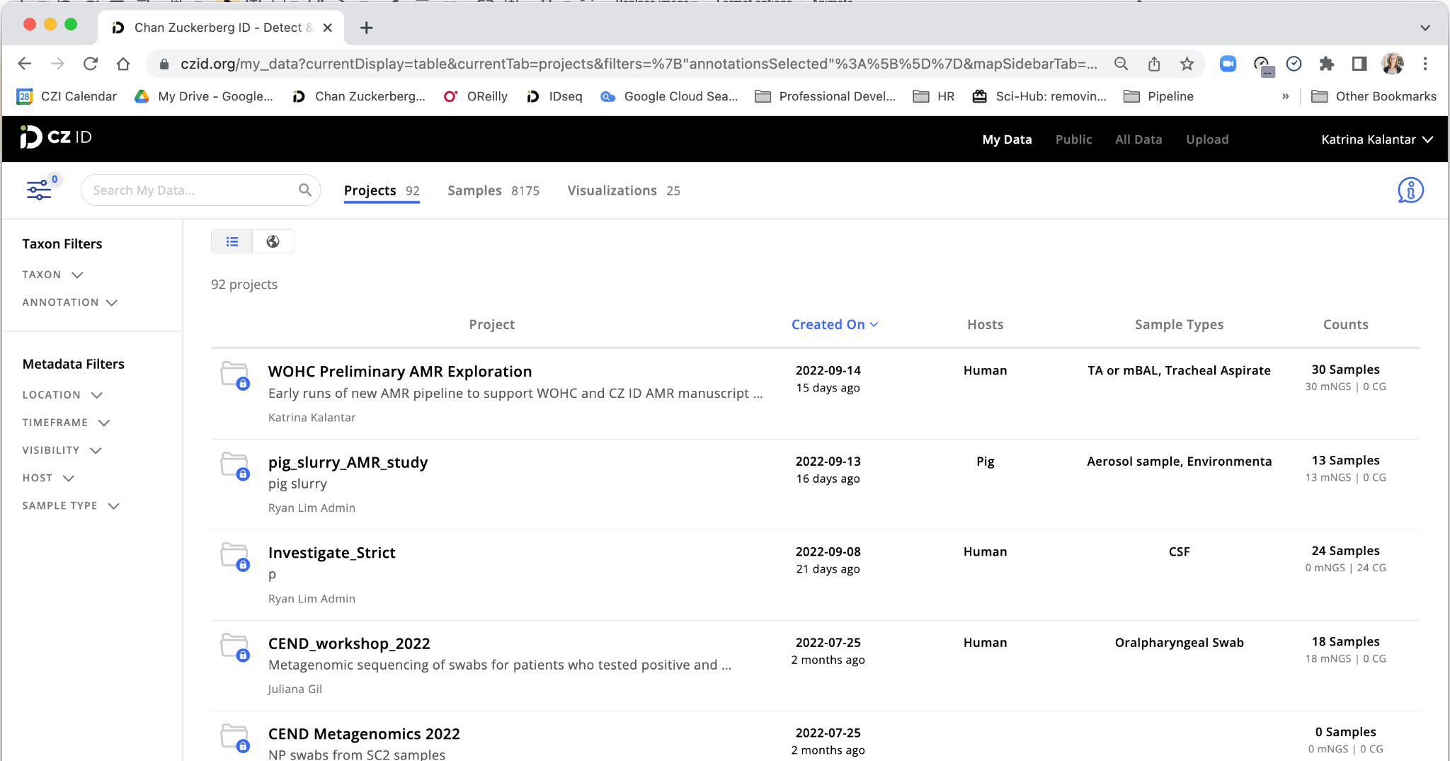
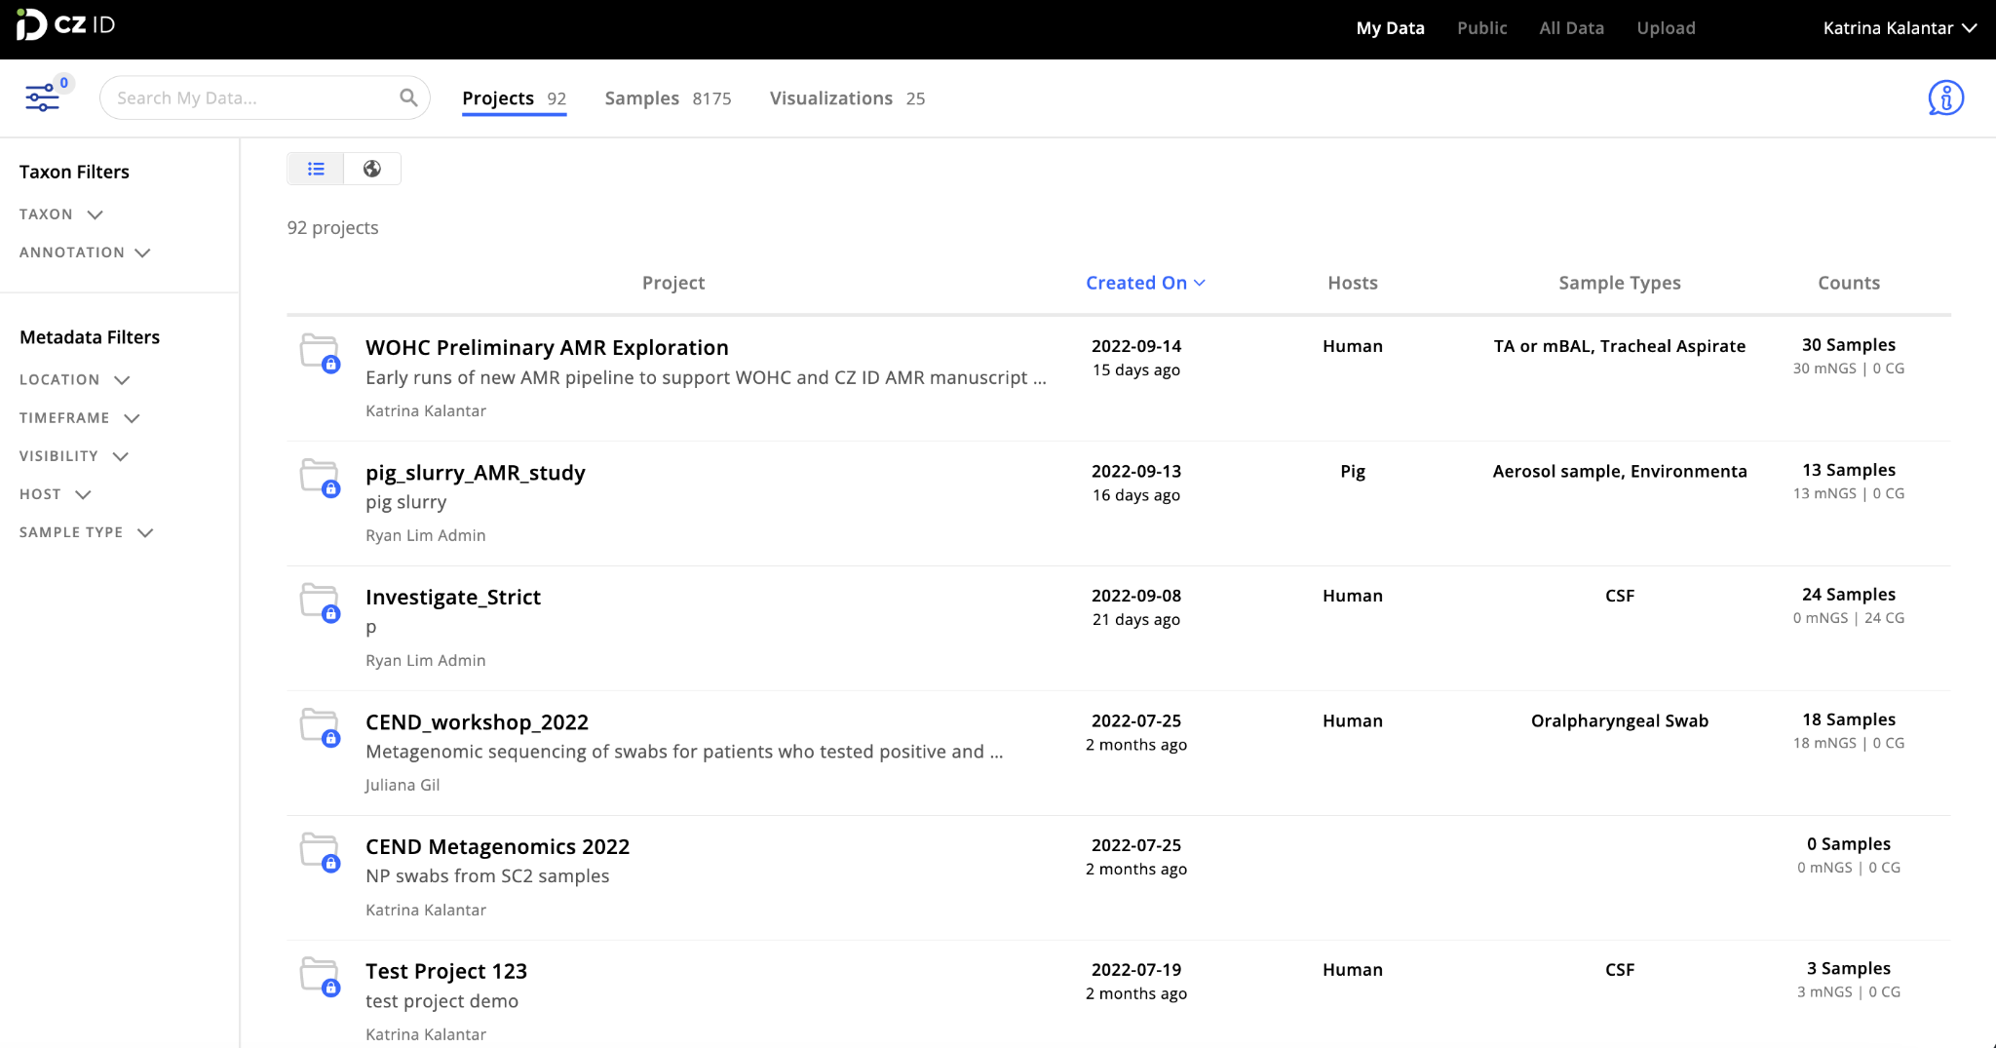
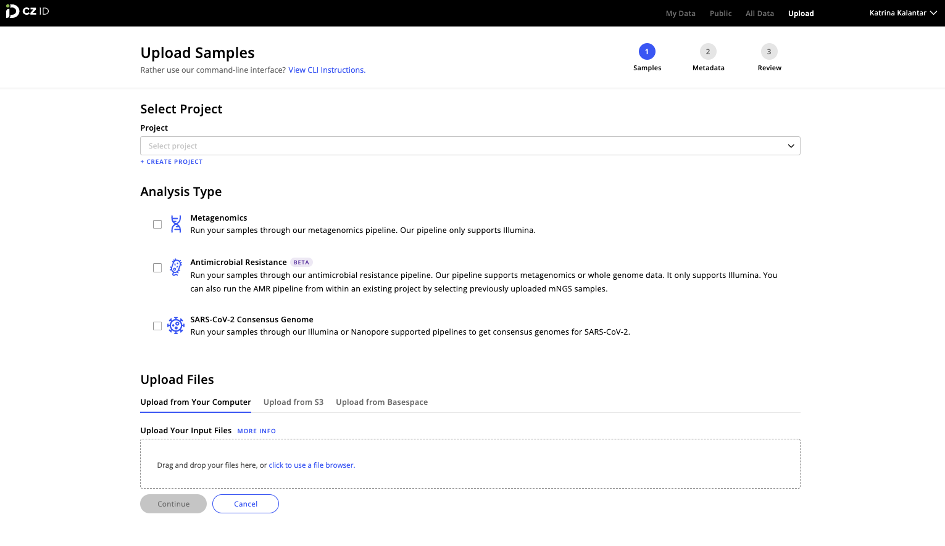
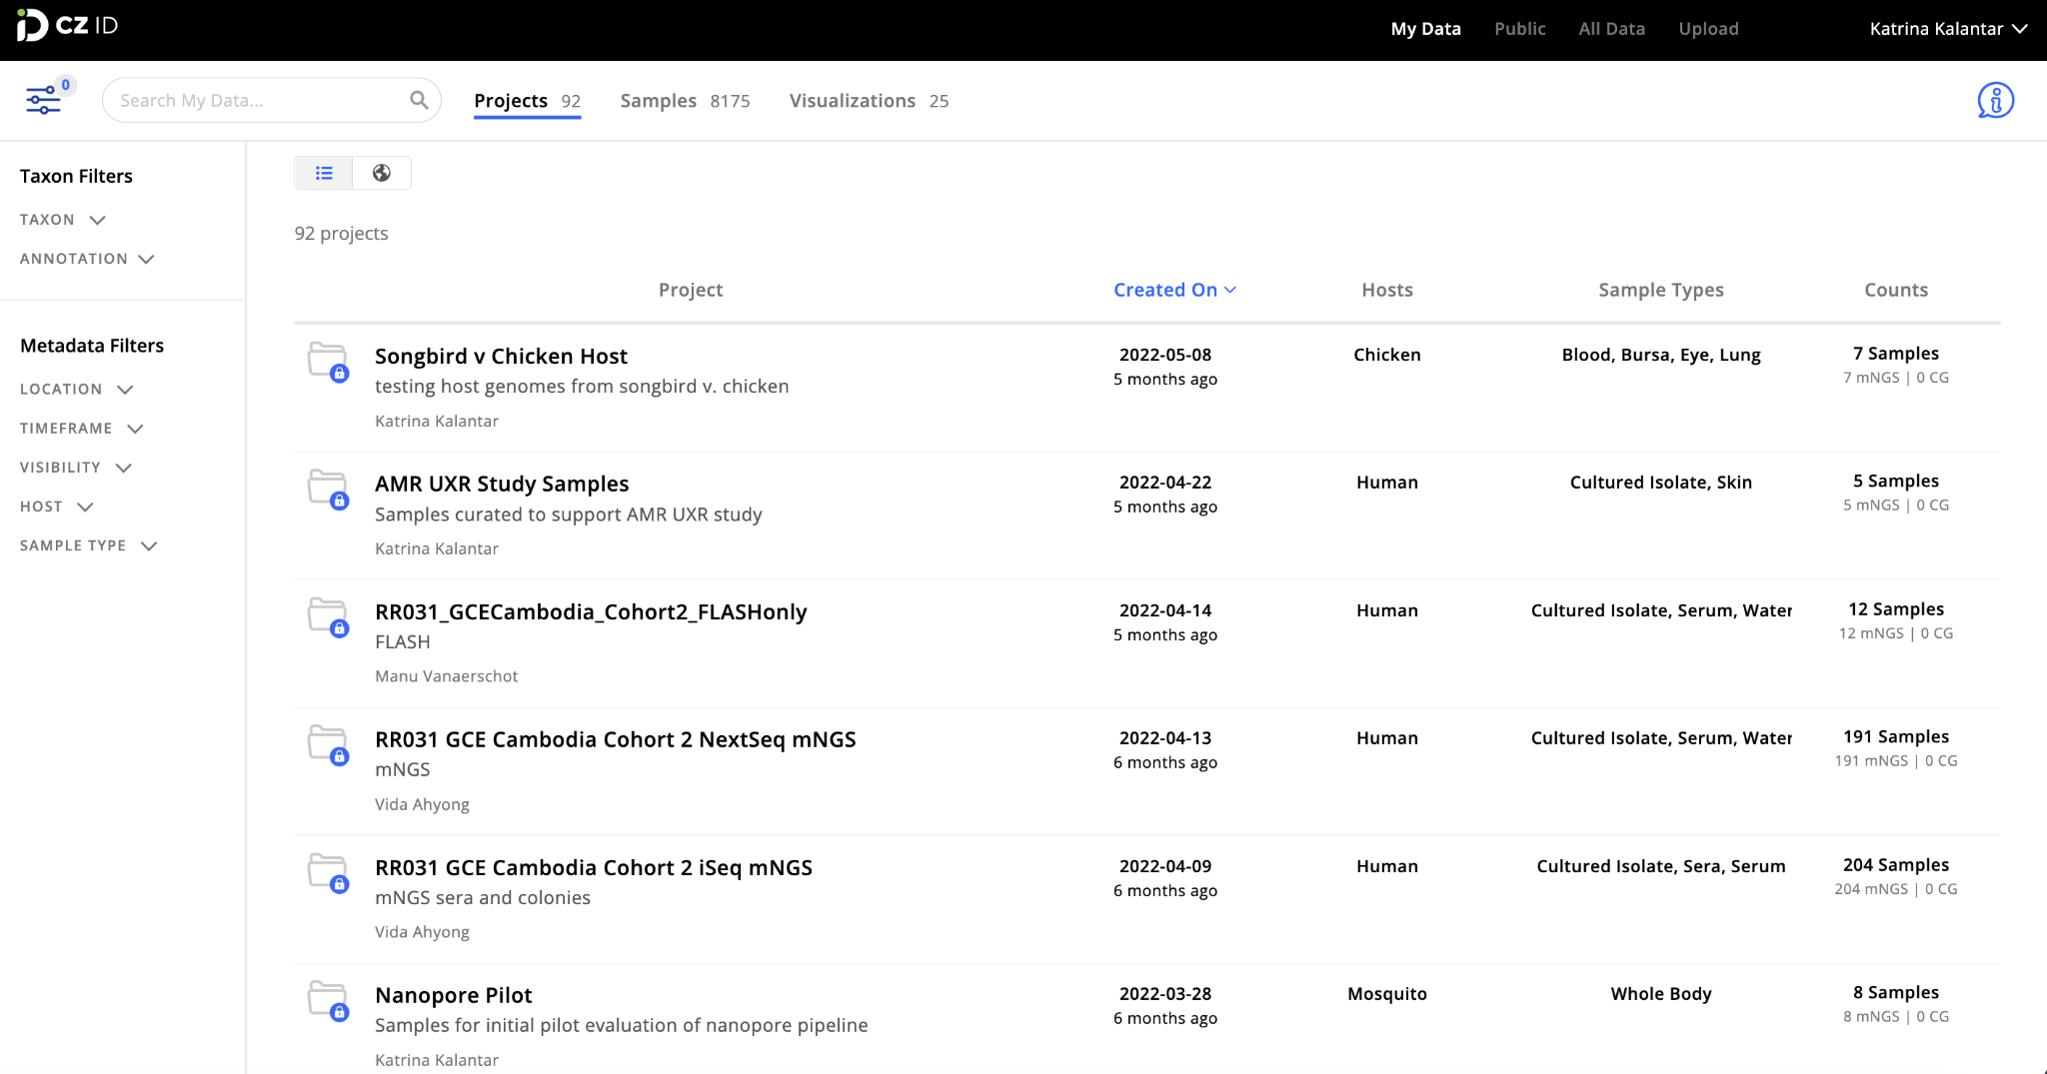

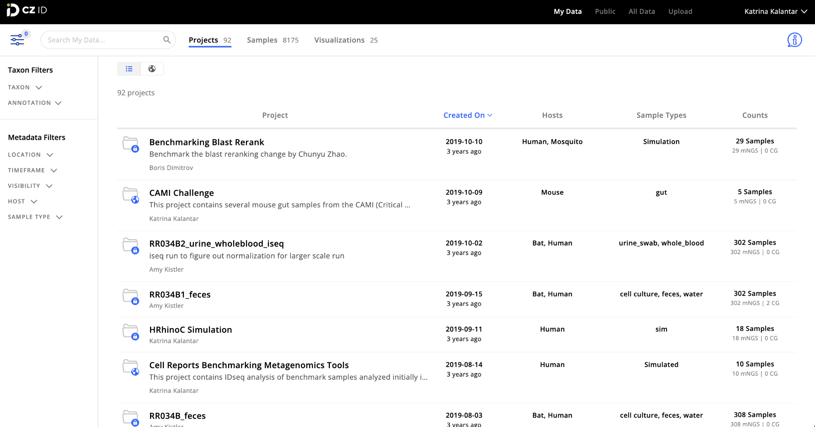
mNGS data analysis
using

Slide 16





No cost
Open source
Cloud-based
Wet lab scientist
friendly

Slide 17
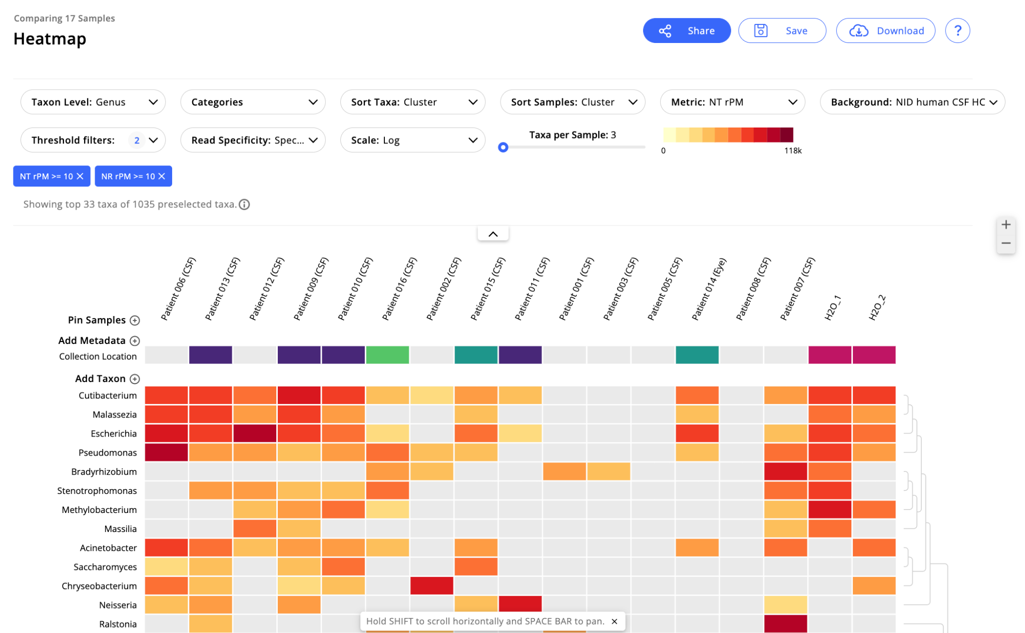
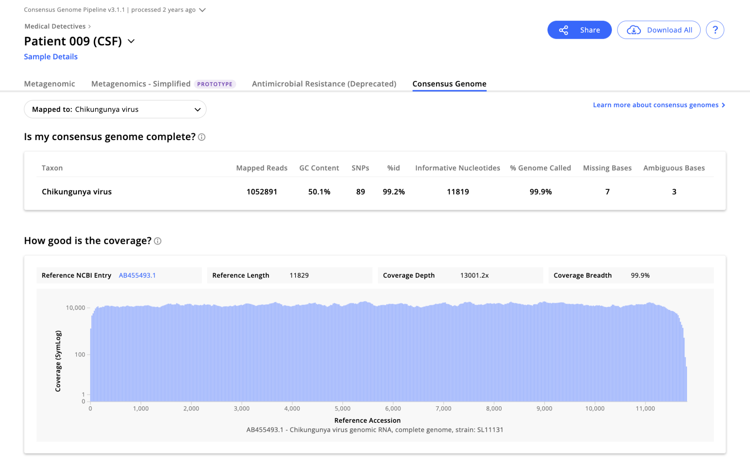
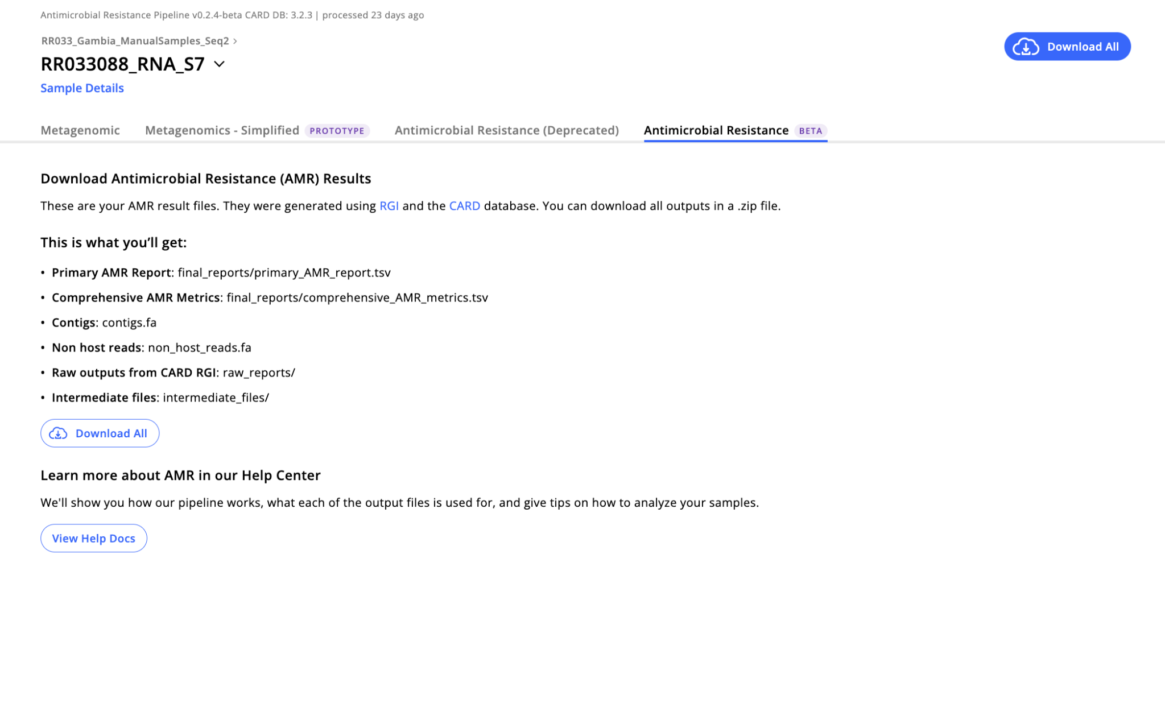
Core Analysis Workflows
Metagenomics (mNGS)
Identify microbes present in mNGS samples and their relative abundance.
Consensus Genomes
Generate virus consensus genomes from mNGS or WGS data.
Antimicrobial Resistance
Detect the presence and abundance of AMR genes in mNGS or WGS samples.
Workflow code is available on GitHub at https://github.com/chanzuckerberg/czid-workflows/

Slide 18
What types of analysis can CZ ID help with?
Determining the infecting microbe in cases of unidentified disease
Identifying novel pathogens
Surveillance of pathogens in a particular region
Understanding the microbial communities in a particular tissue, i.e. respiratory or gut microbiota
Evaluating phylogenetic relationships between samples
Detecting antimicrobial resistance genes in samples
Viral genome assembly (pipelines for SARS-CoV-2 and any other virus)

Slide 19
Metagenomic data analysis using CZ ID
FASTQ Files
mNGS Pipeline
Identified Taxa
⚙️
📄
📄
⚙️
📄
⚙️
Host Filtering and Quality Control
Alignment to NCBI Database of All Organisms
Taxonomic Reporting

Slide 20

Host Filtering and QC
Assembly-based Alignment
Taxonomic Reporting
Raw Sequences
Filtered Sequences
Assemble short sequences into longer sequences (contigs)
Match sequences to a database of known organisms
ACGTACGTACTACTTTCATC

Slide 21
Host Filtering and QC
Assembly-based Alignment
Taxonomic Reporting
Raw Sequences
Filtered Sequences
Assemble short sequences into longer sequences (contigs)
Match sequences to a database of known organisms
ACGTACGTACTACTTTCATC

Slide 22
Host Filtering and QC
Assembly-based Alignment
Taxonomic Reporting
Raw Sequences
Filtered Sequences
Assemble short sequences into longer sequences (contigs)
Match sequences to a database of known organisms
ACGTACGTACTACTTTCATC

Slide 23
Host Filtering and QC
Assembly-based Alignment
Taxonomic Reporting
Raw Sequences
Filtered Sequences
Assemble short sequences into longer sequences (contigs)
Match sequences to a database of known organisms
ACGTACGTACTACTTTCATC

Slide 24
Host Filtering and QC
Assembly-based Alignment
Taxonomic Reporting
Raw Sequences
Filtered Sequences
Assemble short sequences into longer sequences (contigs)
Match sequences to a database of known organisms
Count Taxons
ACGTACGTACTACTTTCATC

Slide 25
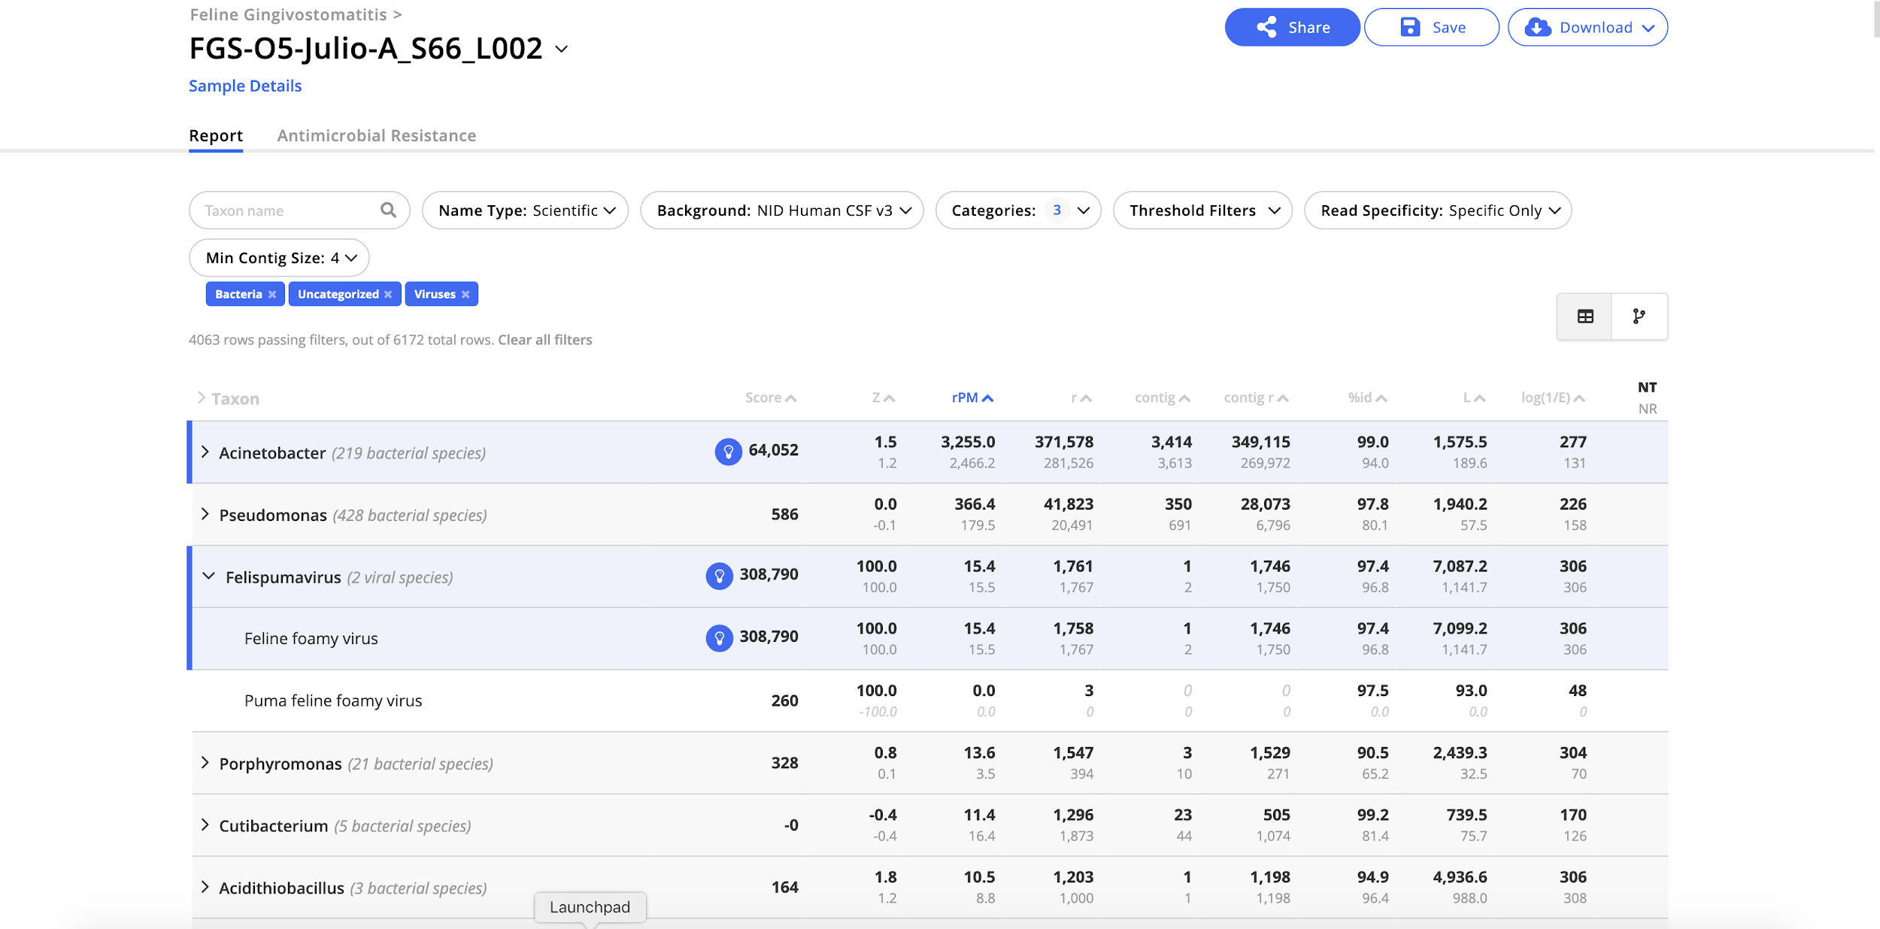
Sample Report: Table View

Slide 26
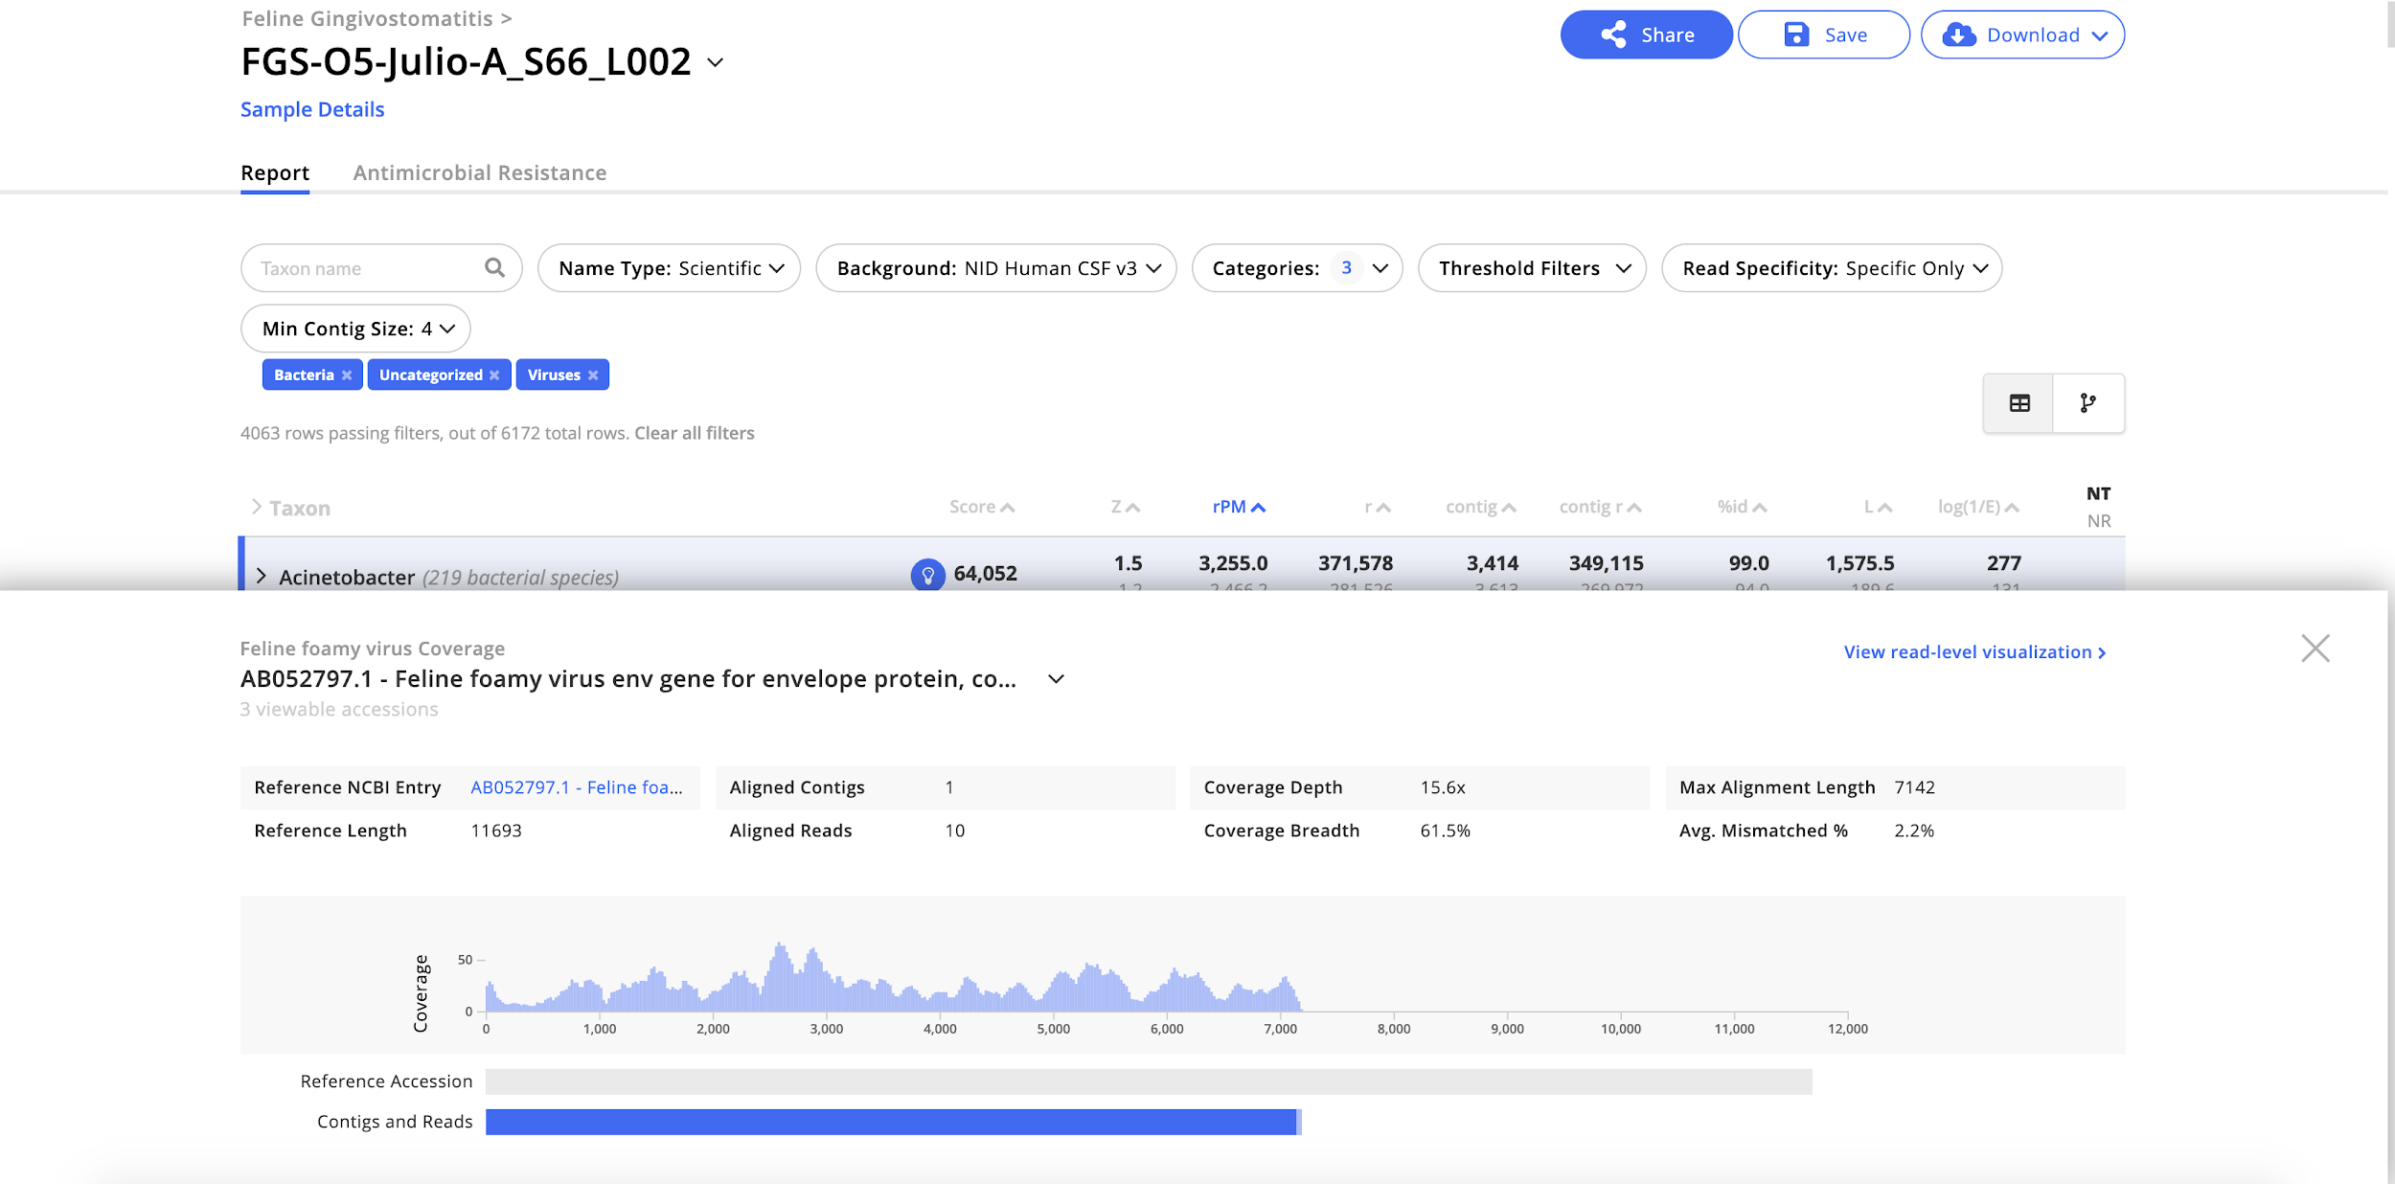
Coverage Visualization

Slide 27
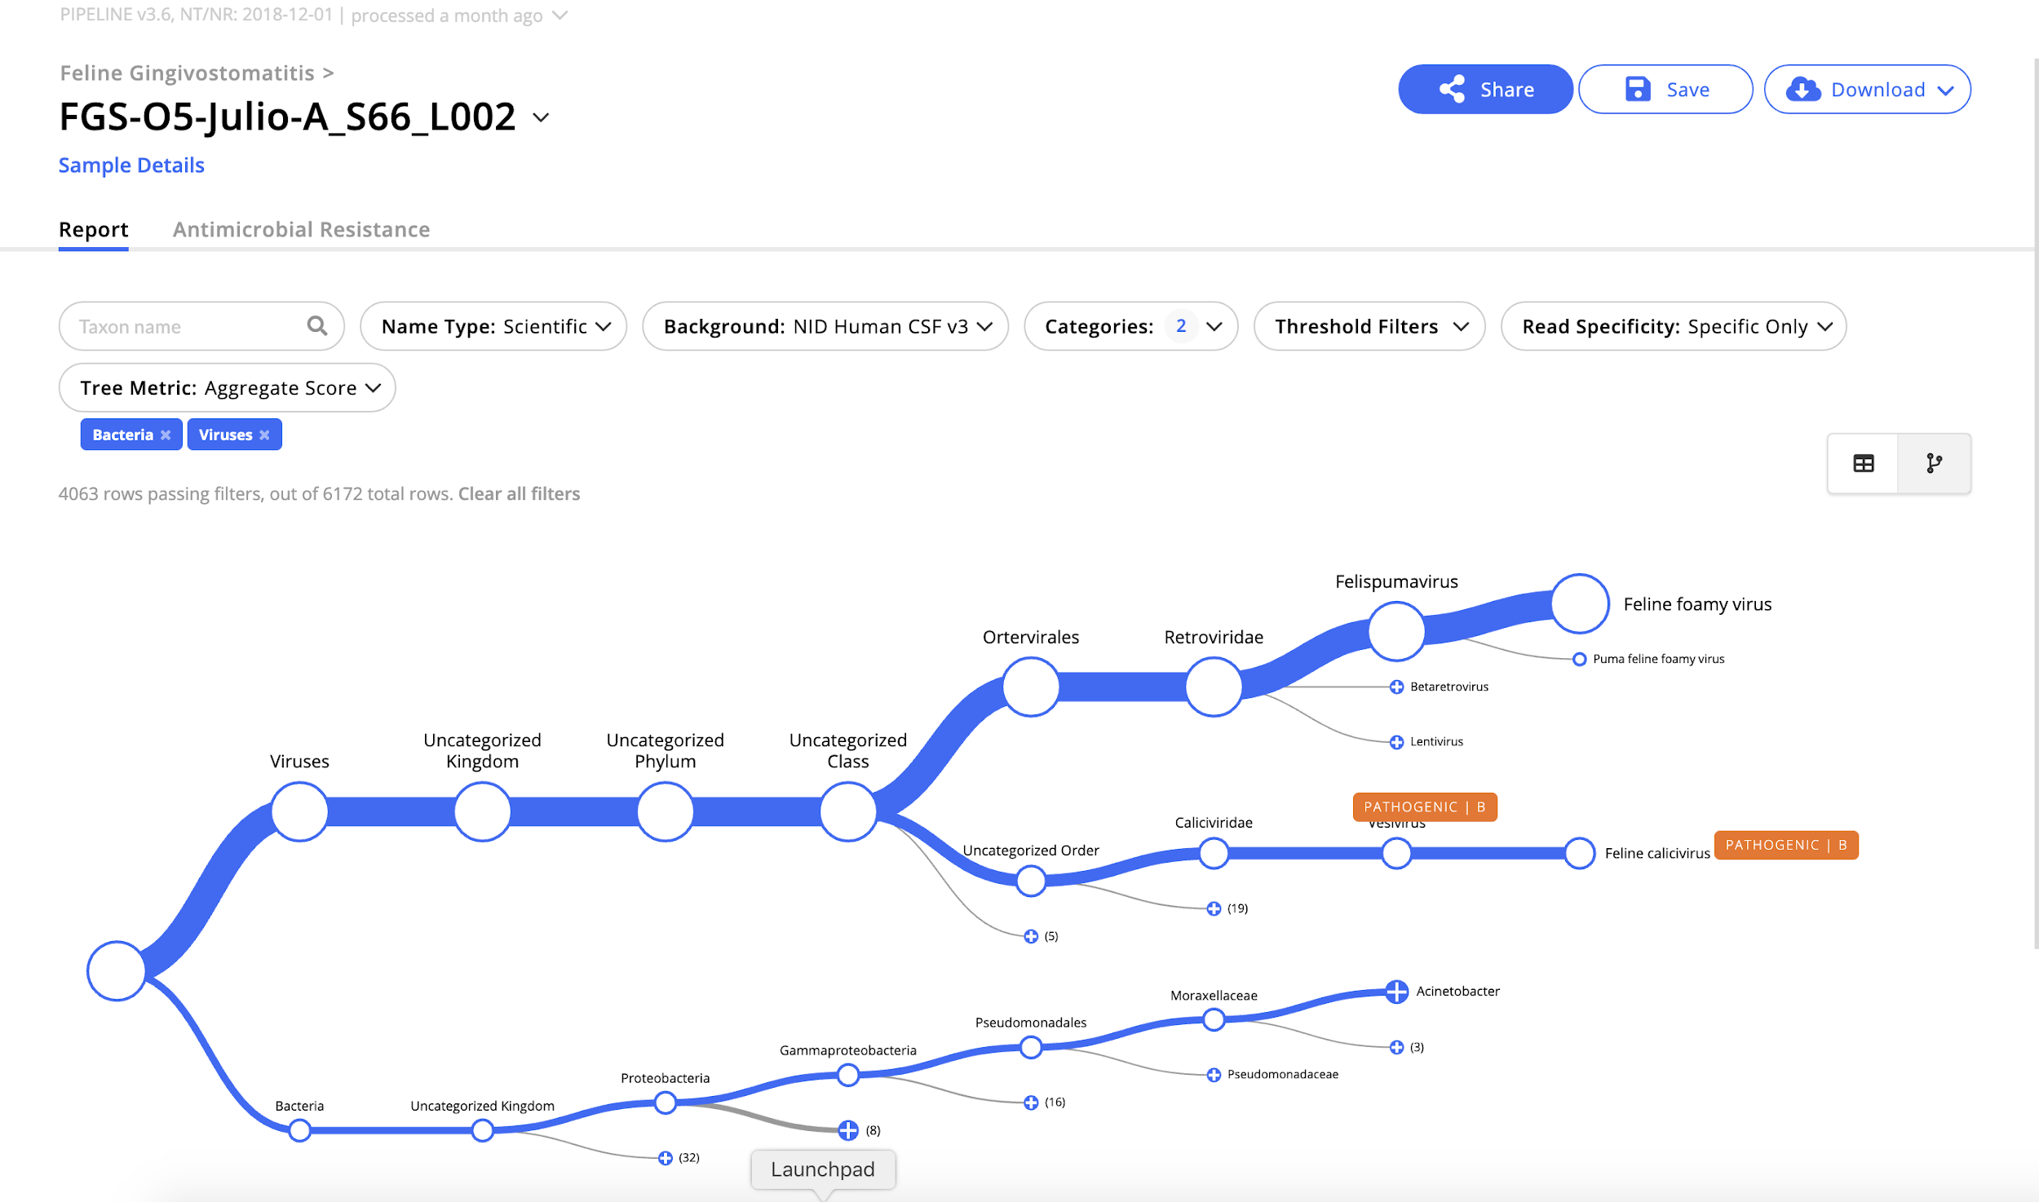
Sample Report: Tree View

Slide 28


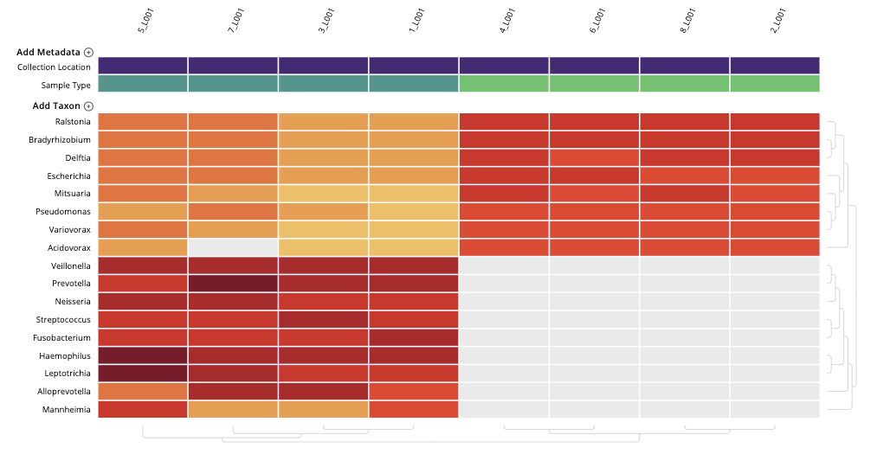
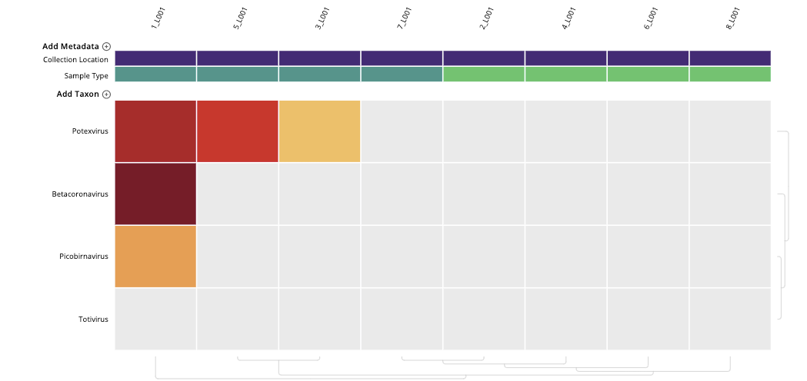
Application: mNGS for SARS-CoV-2 detection in Cambodia
Family Member
Family Member
Family Member
Water control
Water control
Water control
Water control
Index Case
Betacoronavirus
A traveller to Cambodia from Wuhan, China was determined by PCR to have SARS-CoV-2.
NGS was used to evaluate whether the family members also had SARS-CoV-2.
https://public.czid.org/

Slide 29
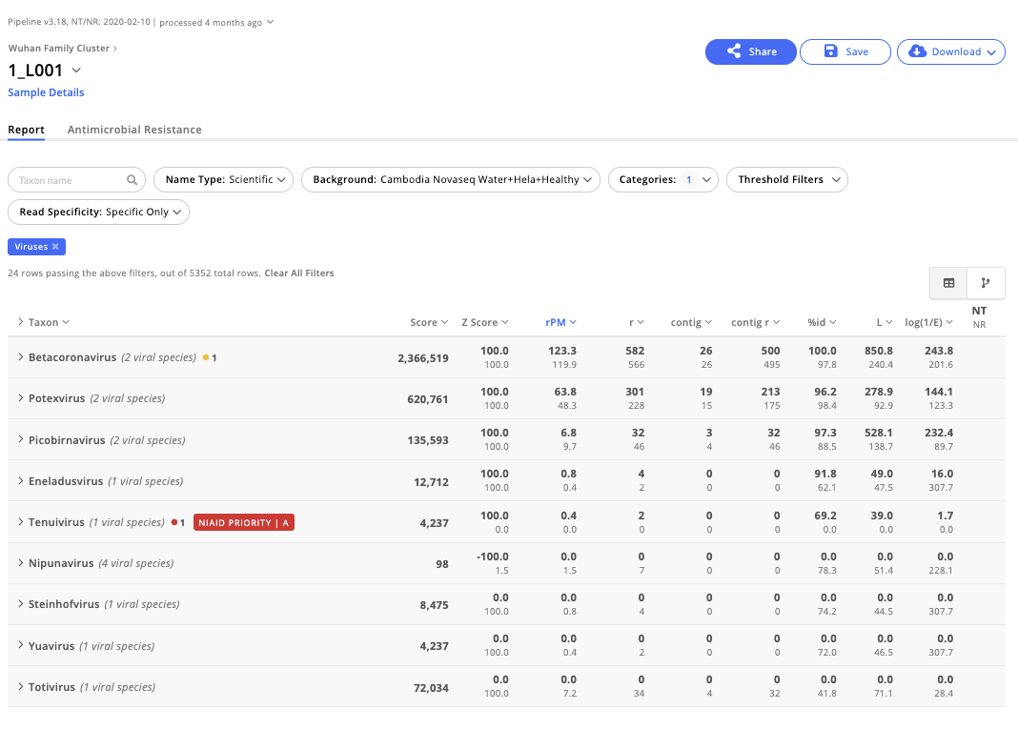
Application: mNGS for SARS-CoV-2 detection in Cambodia
Betacoronavirus
https://public.czid.org/

Slide 30
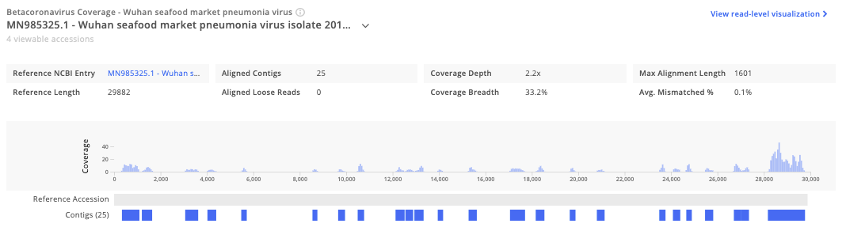
Application: mNGS for SARS-CoV-2 detection in Cambodia
Betacoronavirus
https://public.czid.org/

Slide 31
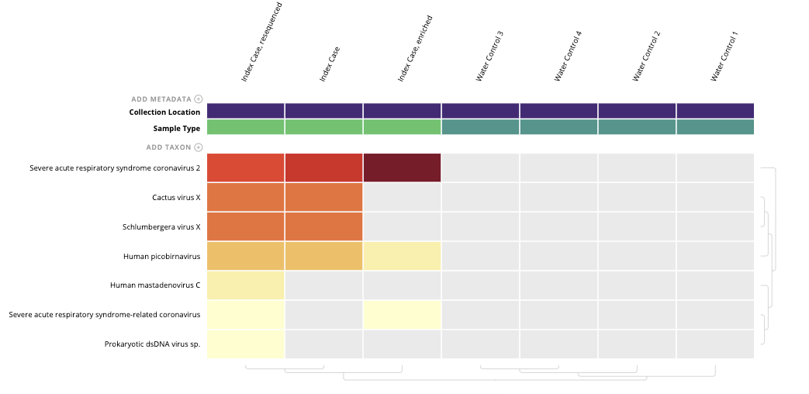
Application: mNGS for SARS-CoV-2 detection in Cambodia
MSSPE
Index Case, resequenced
Index Case, enriched
Index Case
Severe acute respiratory syndrome coronavirus 2
https://public.czid.org/

Slide 32
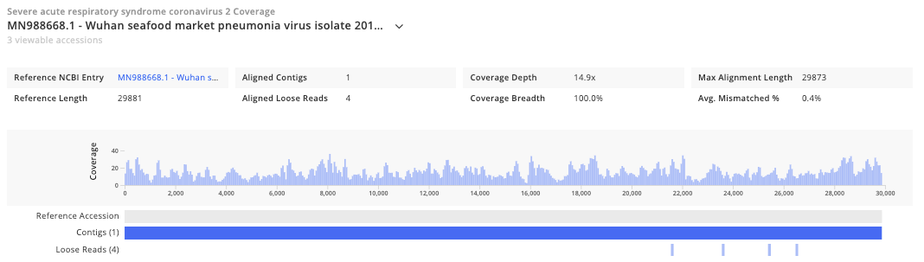
Application: mNGS for SARS-CoV-2 detection in Cambodia
Index Case, resequenced
Index Case, enriched
Index Case
Severe acute respiratory syndrome coronavirus 2
https://public.czid.org/

Slide 33
Application: mNGS for SARS-CoV-2 detection in Cambodia
Cambodian scientists were able to
Confirm the presence of SARS-CoV-2 in the index sample using mNGS
Pivot their laboratory methods to more specific NGS enriching for SARS-CoV-2
Obtained full-length genome sequences
Contribute sequences to global databases
Established a relationship with the Cambodian Government and the Pasteur Institute.
This bridging of organizations means they’re working together towards a common goal of public health!
https://public.czid.org/

Slide 34

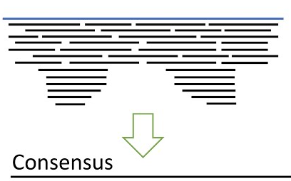



Viral genome assembly using CZ ID
FASTQ Files
mNGS Pipeline
Assembled Genome
⚙️
📄
📄
⚙️
📄
⚙️
Host Filtering and Quality Control
Read Alignment to Reference Genome
Genome Report

Slide 35
Generation of viral consensus genomes
Raw reads
Provide primers used for amplification/enrichment (optional)
Reads mapped to reference
Remove Host
Alignment
Trim Primers
Reference Genome
Consensus Sequence
Call Variants
Call Consensus

Slide 36
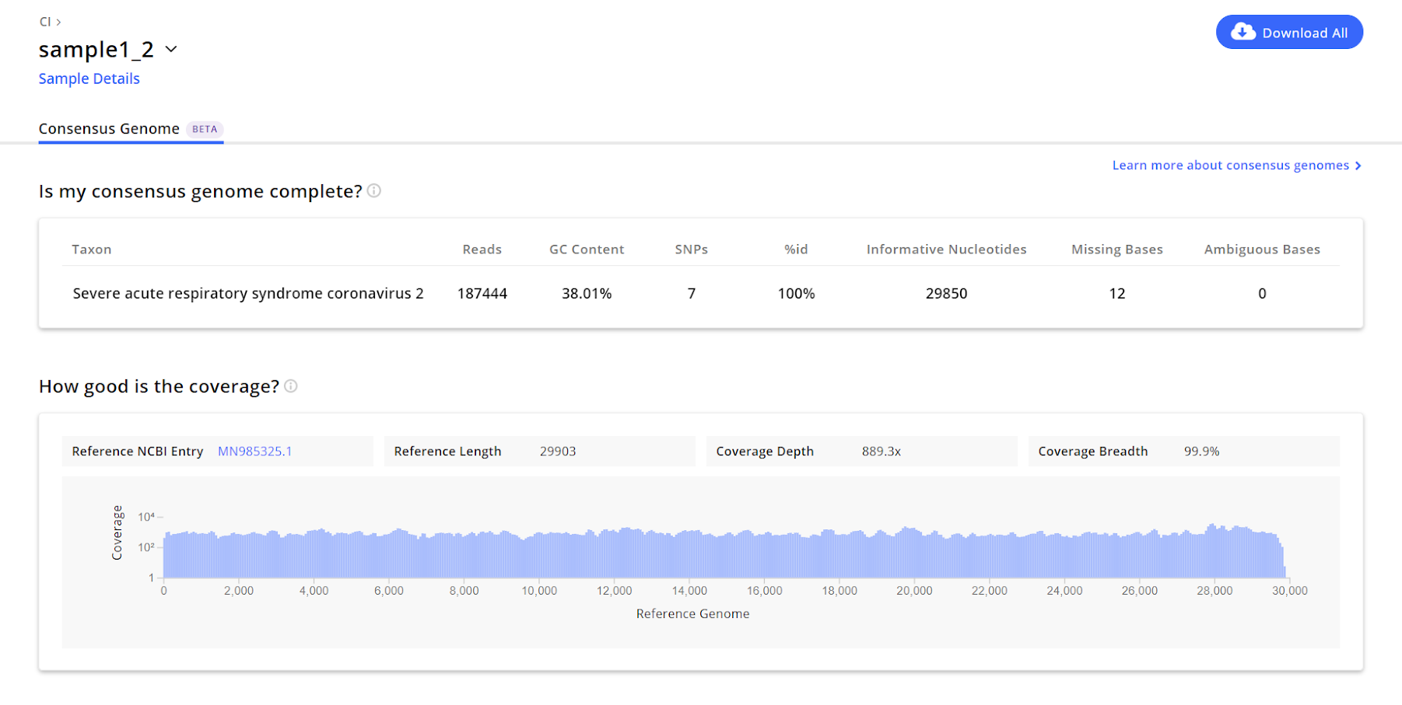
Genome Report
Assembly Metrics
Coverage Stats

Slide 37
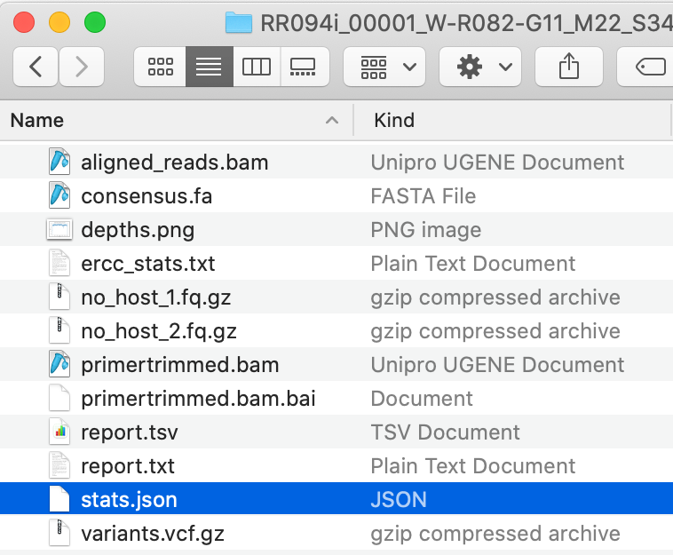
Generated genome data available for download
Download analyzed data
SARS-CoV-2 genome data:
Upload consensus genome to Nextclade for extra QC and visualizing sequence in global/local context
Upload to genome sequence to GISAID nad/or GenBank to share sequence publically

Slide 38
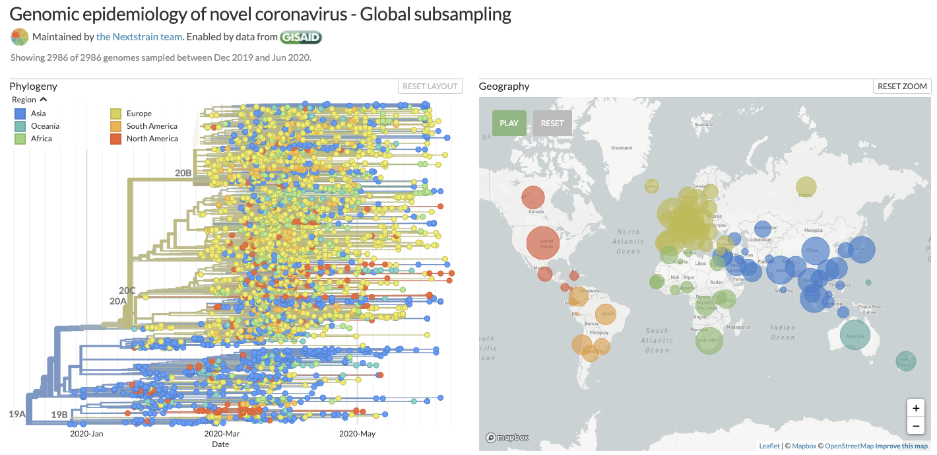
Complete SARS-CoV-2 genomes can be used to evaluate phylogenetic relationships and inform contact tracing

Slide 39
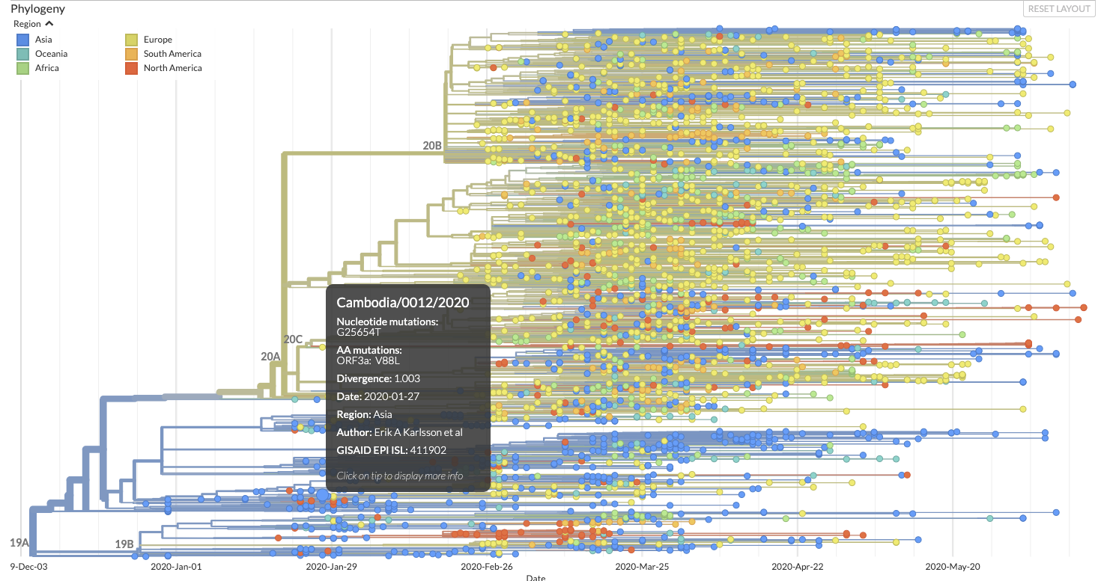
Cambodian SARS-CoV-2 genome descends from Asian lineage

Slide 40
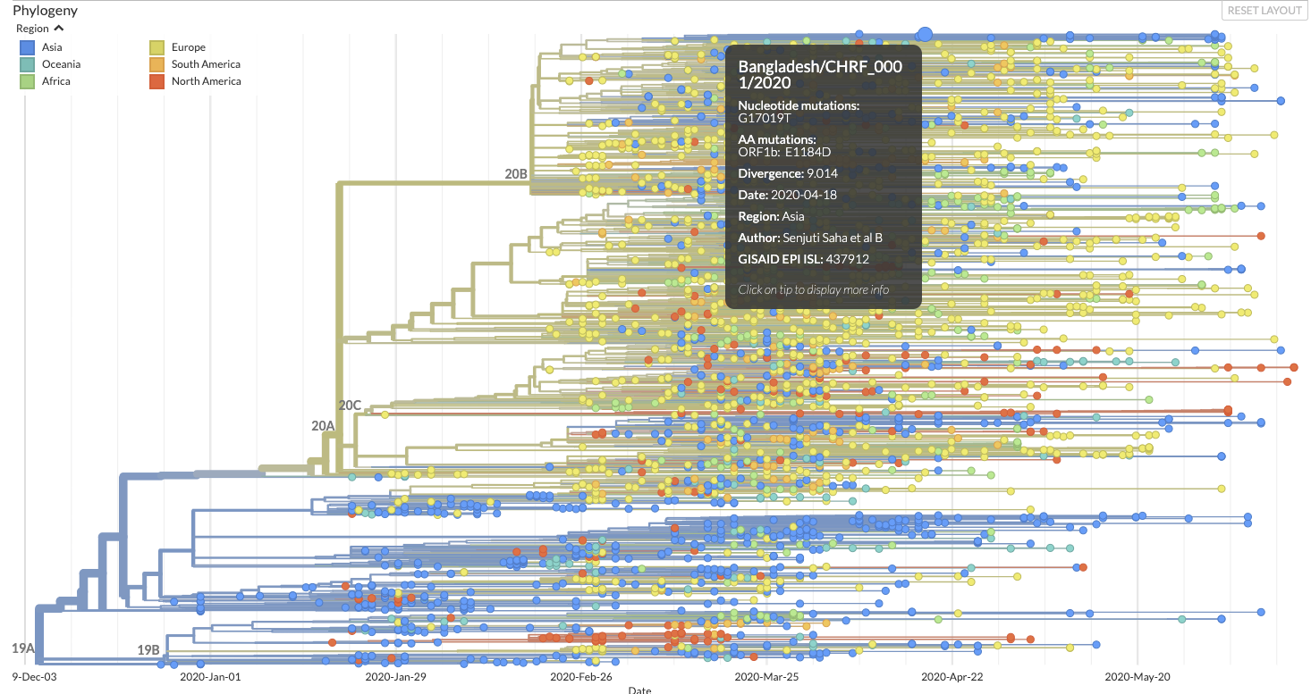
SARS-CoV-2 genomes from Bangladesh descend from European lineage

Slide 41
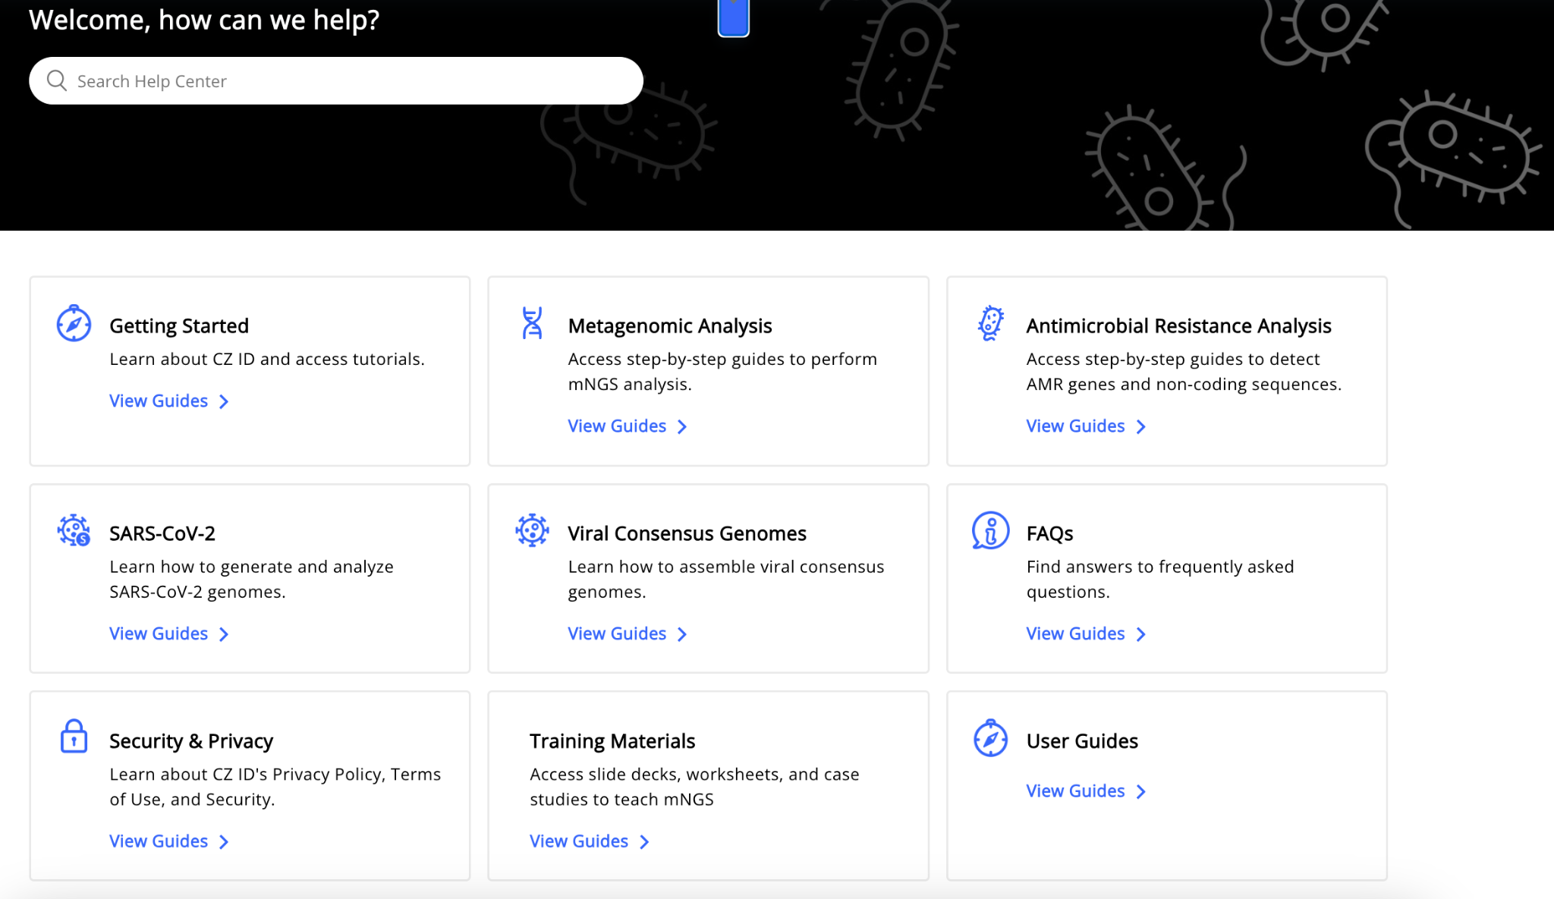
Visit CZ ID’s Help Center to learn more about data analysis & interpretation

